Slide 1
How to Design Solutions that Customers Want Development Skills Applied
Edwin Zhang (@edwin_zh) | Chris Lunsford (@cmlccie) | Joel Obstfeld
DNW23
25 August 2017

Slide 2

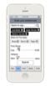
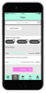
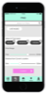
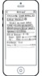
Introducing the Cisco
Design Thinking Framework
Make Things
“What’s Next”
Discover
Define
Explore
Investment
Decision
THE
OPPORTUNITY
PROBLEMS TO
BE SOLVED
WOW
SOLUTIONS
Raw Ideas
High Fidelity
Concept
Validate with Users
[CORE USER] needs to
[PRIMARY NEED] because
[SURPRISING USER-VALIDATED INSIGHT].
Today,
[HOW current solutions fall short.]
As a result of this, our solution absolutely must:
[PRIMARY PROBLEM TO SOLVE],
while
[SECONDARY PROBLEM TO SOLVE],
plus, if possible,
[TERTIARY PROBLEM TO SOLVE].
Problem 1
Problem 2
Problem 3
Notes:
This this cisco design thinking framework which will be published in Oct this year. There are 3 phases. The 1st one is discover the opportunity. how to do that? you engage with customers. You talk to them and ask open questions. This can help reveal direct and indirect issues. You can also watch what the customer does. what they say they do and what they actually do may not be the same. The important thing is to build up the empathy. This is an area that sales group - you guys are very good at. Customer relation is the key to success, right? But we also need to pass on your great insights to the rest of the team. So the rest of the team can contribute to solving customer's problem on every aspects.

Slide 3
Record the insights of your discovery
Discover
[A. CORE USER] needs to
[B. PRIMARY NEED] because
[C. SURPRISING USER-VALIDATED INSIGHT].
Today,
[D. HOW current solutions fall short.]
As a result of this, our solution absolutely must:
[1. PRIMARY PROBLEM TO SOLVE],
while
[2. SECONDARY PROBLEM TO SOLVE],
plus, if possible,
[3. TERTIARY PROBLEM TO SOLVE].
Notes:
One of the tools that we are providing in the discover phase is a standard user story template. You can see there is no features or technology here. It simply focuses on how to capture the insights and explain why it doesn't work today and what problems need to be solved. Insight should be unacknowledged discovery.

Slide 4
Let’s try an example
Discover
Notes:
Let’s go though an example and see how it works.

Slide 5
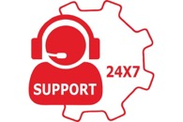
Story
Discover
Rigo has recently grown their customer base to 1 million users, and their customer support case load has increased dramatically.
The current customer support system (including phone, email and forum) is struggling to keep pace. Issue identification and resolution times are increasing leading to decreased customer satisfaction.
Rigo need improve the support experience to keep their customers happy.

Slide 6
Example Use Stories
Discover
[A. CORE USER]
[B. PRIMARY NEED]
Rigo’s customer service staff needs to improve their productivity to enable them to support more customers and reduce issue resolution times, because it takes (on average) five (5) rounds of communication to get the needed context and artifacts to enable the resolution of a case, wait times are high and the customer support resources are spending too much time on information gathering.
Today, Rigo’s customers don’t usually provide clear explainations about the context of the issues they are experiencing. Phone support usually has a shorter resolution time compared to email and the online forums, because the support staff engage the customer live. However, it still takes an lengthy amount of time for customers to explain the scenario clearly and to provide the support staff with the essential ‘artifacts’ that enable the issue to be resolved quickly.
As a result of this, our solution absolutely must: provide a efficient way to collect the case’s essential ‘artifacts’ and interactively engage the customer to clarify the context if needed,
While being able to scale-up easily to support increasing customer accounts,
plus, if possible, we would like to create a new service offer for customers willing to pay a higher premium to receive a higher-touch service level.
[C. SURPRISING USER-VALIDATED INSIGHT]
[D. HOW current solutions fall short.]
[1. PRIMARY PROBLEM TO SOLVE],
[2. SECONDARY PROBLEM TO SOLVE],
[3. TERTIARY PROBLEM TO SOLVE].

Slide 7
Value Proposition Canvas
Discover
Auto-recognize the issue
Attract more customers
Auto-locate the solution
Improve customer satisfaction
Identify support issue
ChatBot
Enable live interaction
Reduced resolution time
Deep learning module
Provide quick resolution
Live video
Collect and analyse data from support artifacts
Long resolution times reduce productivity
Retain customers
Scaling without additional hiring
Customer frustration
Subscription model
High cost of operation
Notes:
VPC can also be used in this phase to record your discovery
Focus on customer first, put your discovery result in the canvas – what jobs or tasks customer needs to achieve, what are the ideal outcomes - gains, what are the outcomes that will make customer unhappy - pains.
And then you can do brainstorming on your solutions, and how your solutions will map back the customer gains and pains.
Again, it’s always putting customer in the center. Solutions come afterward.

Slide 8
Prioritize problems to solve → R.I.C.E
Define
Reach: how many people will this impact? (Estimate within a defined time period.)
Impact: how much will this impact each person? (Massive = 3x, High = 2x, Medium = 1x, Low = 0.5x, Minimal = 0.25x.)
Confidence: how confident are you in your estimates? (in percentage)
Effort: how many “person-months” will this take?
Notes:
As a result of last example, we have a good list of what customer problems are, or maybe even what kind of solution or services you might be able to offer. Now we’ve already entered into the 2nd phase – Define, define the key problems to solve.
The question is from that list of problems or potential solutions/features which one we should start first and which one you need to Drop, because we all have limited resources and time. In this phase, R_I_C_E is one of the tool that will help you prioritize the problems to solve. You can also use it to prioritize potential solution features.

Slide 9
Collected Data & RICE Calculations for our Use Case
Define
Features | Reach | Impact | Confidence | Effort | R_I_C_E Score
ChatBot | 100,000 | 1X (medium); | 100% | 1 FTE | 100,000
Deep learning module
Live video
100,000
2X (high)
80%
1 FTE
160,000
5,000
2X (high)
100%
2 FTE
5,000
Reach: how many people will this impact? (Estimate within a defined time period.)
Impact: how much will this impact each person? (Massive = 3x, High = 2x, Medium = 1x, Low = 0.5x, Minimal = 0.25x.)
Confidence: how confident are you in your estimates? (in percentage)
Effort: how many “person-months” will this take?
Notes:
Let’s take a look at another example. Following our previous story, we came up 3 potential features to help solve Rigo’s problem. 1) a ChatBot for customer support, 2) a deep learning module, 3) live video support session. A quick estimation, we guess the ChatBot probably will cover100,000 customer out of 1 million. The Impact will medium. We have 100% confidence to deliver it. And we will need 1 engineer’s time for that. So the total score would be 100,000. Okay, let’s try the other two, what’s your estimation here.
So based on the score, the higher number means high priority, and that’s what we are going to start first.
BTW, the RICE score can be done from collaborative effort, e.g. account manager probably better at Reach and Impact, while engineers probably better at Confidence and Effort. You got the idea.

Slide 10
Let’s Design & Test
Explore
Proposed solution:
Use Cisco spark together with a deep learning system to engage with customers, and automatically identify the customer artifacts and provide solutions.
Prototype in 7 steps:
In the workshop, you will build a prototype to show when customer uploads a photo of an object to Cisco spark, it will talk to an open source deep learning library to identify the object and return the related topics and options.
Notes:
Once we have an agreed solution based on prioritization, we can move into the 3rd phase – Explore. In this phase, we will focus more on building up a prototype and validate with customers. The prototype doesn't need to be a full fledged application. It needs to demonstrate the high level experience and show the feasibility. In today’s workshop, let’s build a spark integration with a deep learning module in 7 steps. I will walk you though it step by step.

Slide 11
Demo-able Prototype
Explore
Webhook handler script
TensorFlow docker image
A tunnel between local machine and cloud
Cisco Spark cloud service
configuration file
Spark script
Local laptop
Notes:
The scenario we try to enable is – have a way to trigger a room creation and add webhook to monitor that room, when an image is uploaded to the room, the webhook handler module can grab the image and pass it to deep learning module – TensorFlow to process. Once the process finished, the handler needs to send the result back to spark room as a chat message.
Here is the basic “Marchitecture” diagram for our prototype. The key is the leverage existing resources and make it work for your scenario. We want to put most of things on your local laptop to avoid the cloud deployment steps. So we will use ngrok to create a tunnel between local machine and Spark cloud service. For the deep learning module, we found some an open source tool called TensorFlow and there are plenty libraries on GitHub already, so we will take advantage of that – to use one of the Docker images. And we will need one script to create Spark room for the ChatBot, and add a webhook to monitor that room. We will need another script to send the image to deep learning module for analysis when the webhook is triggered and return the result back o spark room. Okay, are you ready to develop?

Slide 12
Explore
Build a deep-learning docker image based on TensorFlow with pre-training data
Run ngrok for demo connection
Register your Spark Bot
Login developer.ciscospark.com, go to “My Apps” and create your Bot
Update the token, account and ngrok URL in config.py
Run ciscospark.py to create a direct room and add a webhook
Run webhook.py to recognize image when webhook is triggered
Now upload a image to your spark bot room and test it out!
$ cd DT
$ docker build . –t dtimg
$ ./ngrok http 5000
$ open config.py
# cmd+T to open new tab
$ python ciscospark.py
$ python webhook.py
Notes:
Let’s do this together. Step 1 …

Slide 13
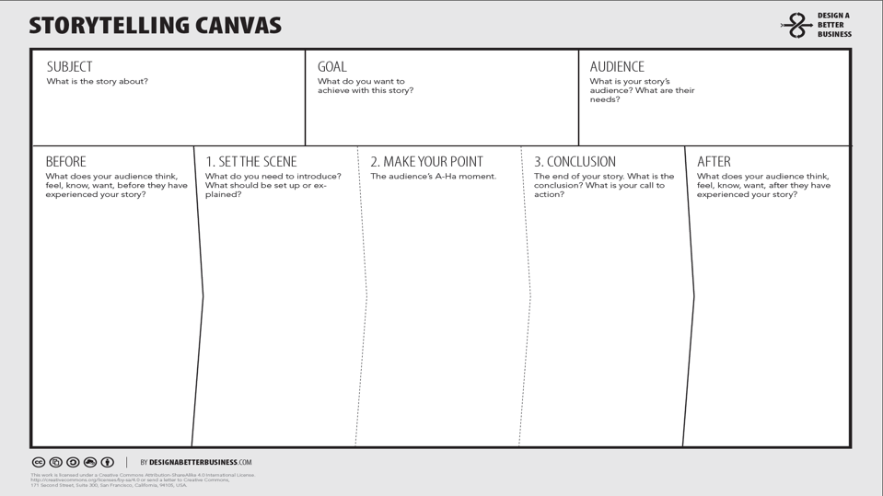
Explore
We know that customer satisfaction is essential to your growing business. You don't want your customer to wait 15 mins on hold waiting to speak with your support staff.
You want to provide your customers with timely access to information that may enable them to resolve their issues on their own; and should they need to speak with a customer support resource, you want to provide that resource with the essential information they need to resolve the customer’s issue quickly.
By combining open-source deep-learning AI technology with the extensibility of Cisco Spark, we can provide your customers with a convenient way to post the artifacts associated with their issue, enable intelligent self-help, and provide an engaging space to collaborate with your support staff.
Let’s walk through a typical customer support request…
Notes:
Now you have a working prototype to show customer, what are you going to say about it? How to make your pitch?
Storytelling canvas is another tool that can help you in this phase. It’s a framework for putting the ‘customer’ at the center, Sharpening the message, and Defining the ‘call to action’.
I know sales folks are very good at making customer pitch, so you probably will write better stories. Here is my example for your reference.

Slide 14
Wrap-up
Notes:
Alright, we are almost at the top of the hour. Let’s do a wrap-up about today’s session.

Slide 15
Discover
Define
Explore
THE
OPPORTUNITY
PROBLEMS TO
BE SOLVED
WOW
SOLUTIONS
Discover opportunities offered by APIs
Defining & Prioritizing
Prototyping & Storytelling
AM (Account Manager)
SE (System Engineer)
Notes:
We talked about the 3 phases of Cisco design thinking framework, and shared several tools for the 3 phases. As you can see, account manager and system engineer can have different activities in each phases.

Slide 16
Where to learn more…
Technical info about the components we used in our use case prototype:
https://learninglabs.cisco.com (learn about docker, CiscoSpark, python, etc)
https://www.docker.com
https://ngrok.com (secure tunnel to local host)
https://www.tensorflow.org (Open-source software library for machine intelligence)
More Design Thinking material:
https://www.designbetter.co/books
https://design.cisco.com (coming soon)
Notes:
Thank you for attending the session. I’d like to hear some feedbacks from you about this session. And if you want to learn more about the content we talked today, here are some useful links. Thanks for you time and attention.

